Slide 1
EDUC 200C
Section 4 – Review
Melissa Kemmerle
October 19, 2012

Slide 2
Goals
Review regression and measures of fit
Review Spearman correlation and relationship to Pearson correlation
Talk briefly about normal distributions
Quick review of everything—midterm next Wednesday
Questions

Slide 3
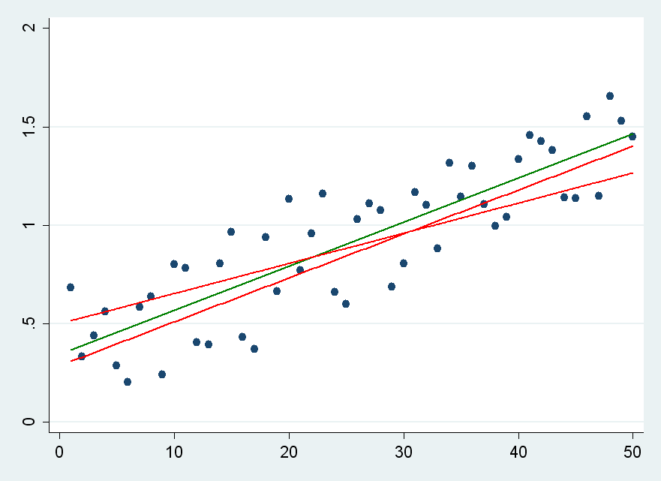
Regression
Use regression to predict how one variable changes in response to another variable.
Prediction line is calculated by minimizing the total squared difference between the line representing our prediction and the actual data

Slide 4
Regression line notation and formulas
Y’ = b_{YX}X + a_{YX}
Regression line slope: b_{YX} = r_{YX} (σ_{y} / σ_{x})
Regression line intercept: a_{YX} = Y - b_{YX}X

Slide 5
How do we know if we’ve explained the data well?
Standard error is the same as standard deviation except that we look at deviation from the prediction rather than deviation from the mean

Slide 6

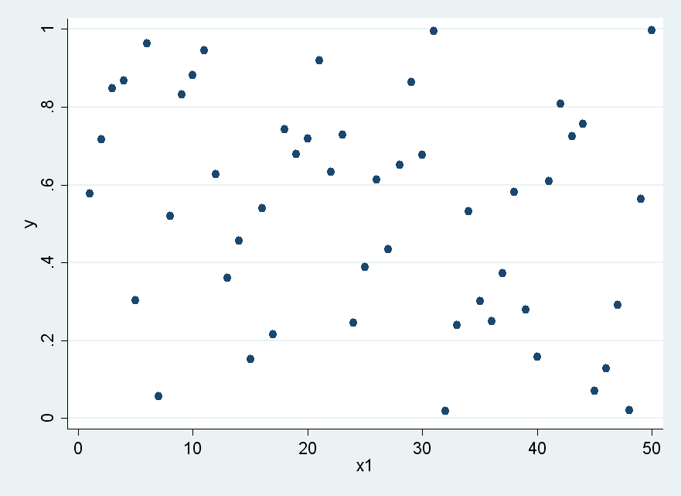
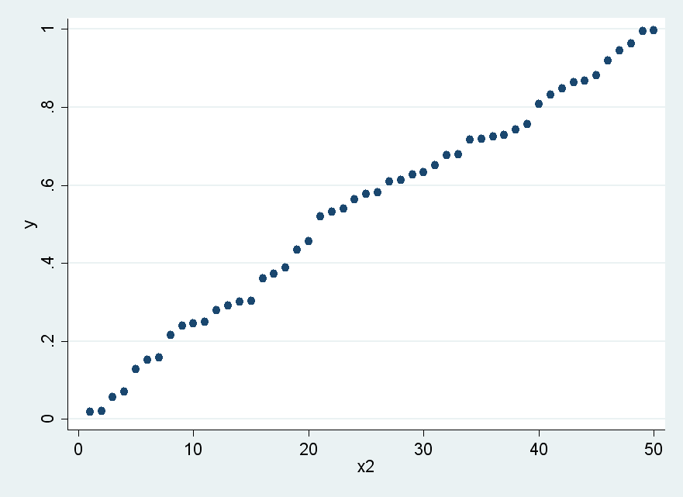
Extreme examples
Same Y data with differing relationships to X

Slide 7
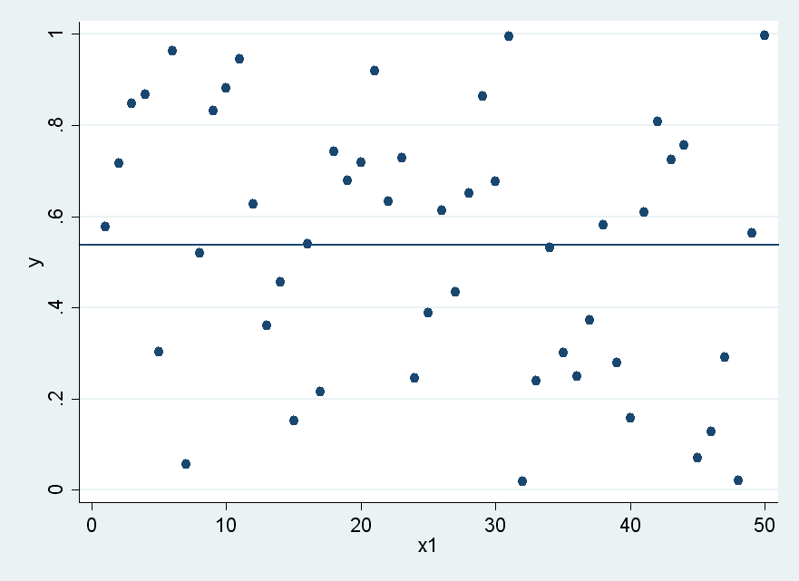
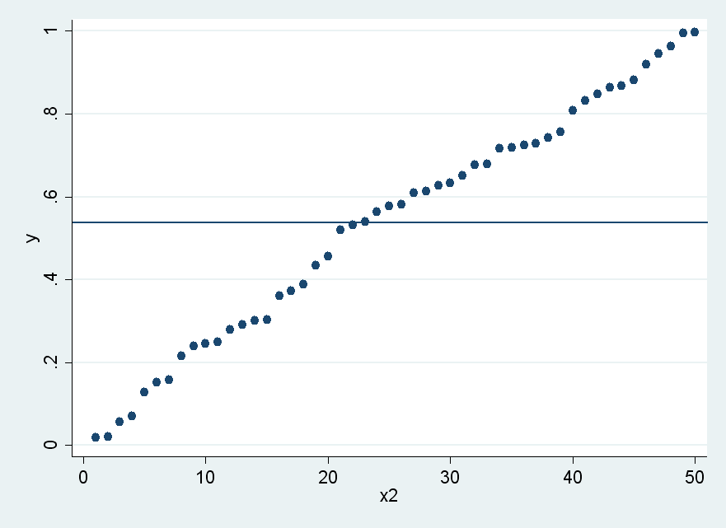
Standard Deviation is relative to the mean
Since the Y data is identical in both graphs, the total variance of Y is also identical

Slide 8
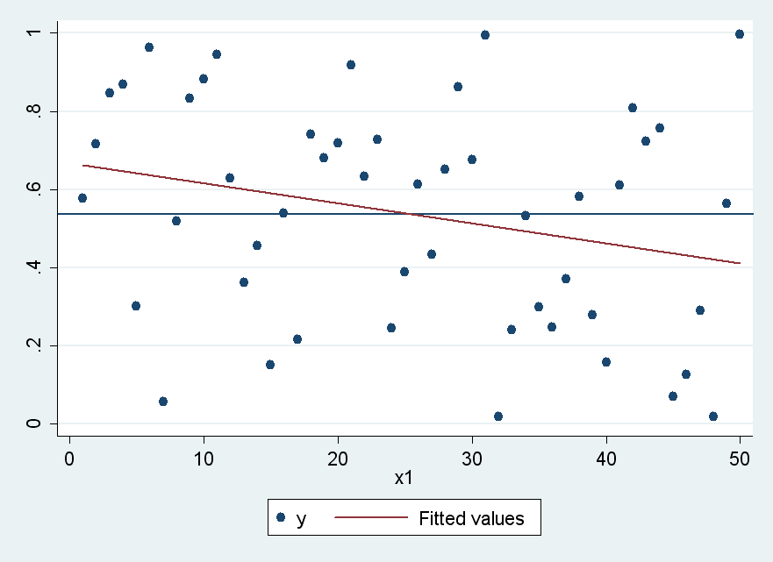
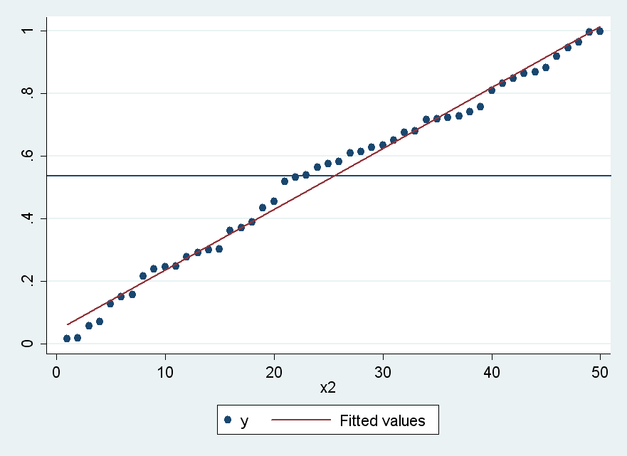
Standard Error is relative to the prediction
The different relationships of Y to X is reflected by how close predicted values of Y are to actual values

Slide 9
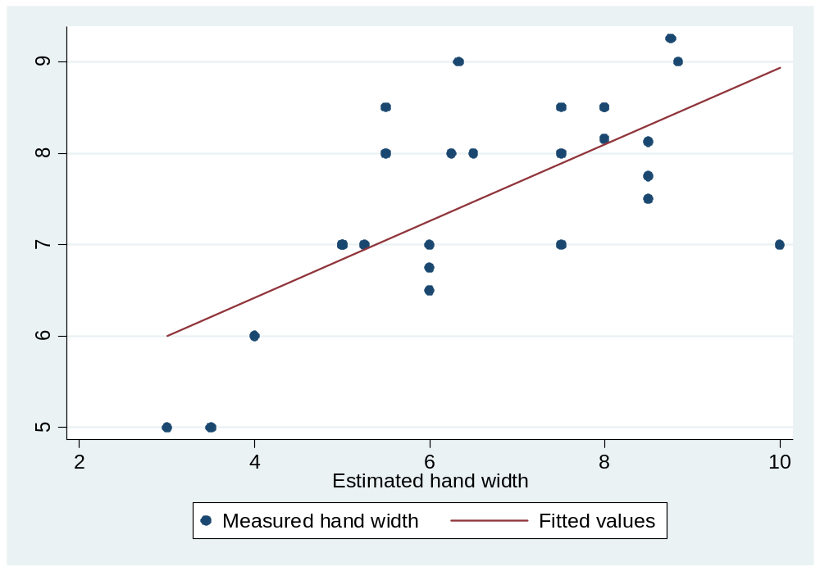
Explained vs. Unexplained variance

Slide 10
How much variance have we explained?
You can crudely think of the error variance as how much variance in Y is “left over” after accounting for X
  Knowing X gets us close, but probably not all the way, to knowing Y
gives the percent of total variance in Y that we have not explained with X
thus gives percent of variance in Y explained by X
  Conveniently, this is equal to
  Can also think of this as the percent of shared variance between X an Y

Slide 11
Stata…
Error variance, s_{Y’}²
R-squared, r_{YX}²
. Reg Y X
Source | SS df MS Number of obs = 50
-------------+------------------------------ F( 1, 48) = 4312.81
Model | 3.92107903 1 3.92107903 Prob > F = 0.0000
Residual | .043640216 48 .000909171 R-squared = 0.9890
-------------+------------------------------ Adj R-squared = 0.9888
Total | 3.96471925 49 .080912638 Root MSE = .03015
------------------------------------------------------------------------------
Y | Coef. Std. Err. t P>|t| [95% Conf. Interval]
-------------+----------------------------------------------------------------
X | .0194055 .0002955 65.67 0.000 .0188114 .0199996
_cons | .0418653 .008658 4.84 0.000 .0244573 .0592733
------------------------------------------------------------------------------
Note that these values have bias corrections that make them more like s than σ
Total variance, s_{Y}²
Standard error, s_{Y’}

Slide 12
Spearman Correlation
Identical to Pearson correlation except that we are specifically dealing with rank-order data rather than continuous data
  Gives a measure of the relationship of the relative ranks rather than relative values
  Where D is the difference in ranks, rather than difference if values, for the same observation

Slide 13
Spearman vs. Pearson
When using rank-order data, using the Spearman formula and the Pearson formula will give you identical results
The Spearman rank-order correlation coefficient is usually different from the Pearson r correlation coefficient if the Pearson r is calculated using untransformed data (i.e. not rank-order data)
  Consider the case where you keep increasing the highest value of one of the variables of interest—this will affect the Pearson correlation, but not the Spearman correlation

Slide 14
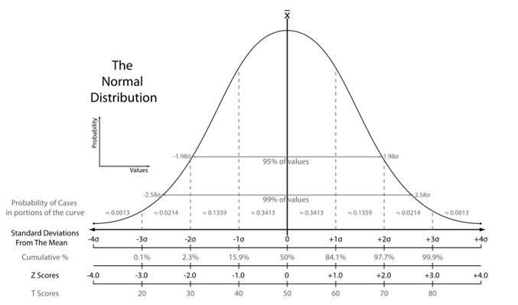
The Normal Curve

Slide 15
The null hypothesis
Example: A study compares the results of a new reading program for middle school students. In this study, 36 students received the experimental reading program
Each student’s reading score was measured before and after the program. The variable of interest was score change
Score change was positive if a student’s score improved and negative if the score got worse
What is our null hypothesis?

Slide 16
Hypothesis testing vocabulary
Null Hypothesis: A hypothesis to be tested.
Use the symbol H₀ (e.g. H₀ : μ=0)
Alternative Hypothesis: A hypothesis that represents the opposite of the null hypothesis
One or the other must be true, there can be no third option
Use the symbol H_{A} or H₁ (e.g. H_{A} : μ≠0)
Hypothesis Test: The test of whether the null hypothesis (H₀) should be rejected in favor of the alternative hypothesis.

Slide 17
Questions so far?

Slide 18
Review of Everything
Measures of central tendency
  Mean:
  Median: value greater than 50% of all other observations
  Mode: most common value

Slide 19
Review of Everything
Measures of Spread
  Population variance, σ²:
  (Unbiased) sample variance, s²:
  Population standard error, σ:
  (Unbiased) sample standard error, s:

Slide 20
Review of Everything
Z – scores
  Data transformation to give data a mean on 0 and a standard deviation of 1

Slide 21
Review of Everything
Correlation
  Pearson r correlation coefficient
    Z-score difference formula
    Z-score product formula
    Raw score formula

Slide 22
Review of Everything
Correlation
  Spearman rank-order correlation coefficient

Slide 23
Review of Everything
Regression
  Predict Y from X:
  Error (or residual):

Slide 24
Review of Everything
Regression
  Standard error:
  R-squared:
  R² gives us the percent of variance in Y explained by X. This is sometimes called percent of shared variance.

Slide 25
Questions?

